Slide 1

Hadoop : A Highly Available and Secure Enterprise
Data Warehousing Solution

Slide 2





What will you learn today?
What is Big Data
Hadoop: A synonym for Big Data
Hadoop High Availability
Hadoop as a Data Warehouse
Hands-On: Achieving NameNode and YARN high availability
Hands-On: Securing through ACL

Slide 3

What is Big Data ?
What is Big Data

Slide 4

Big Data

Slide 5

How Big Data is stored ?
How do you store Big Data, I guess RDBMS?

Slide 6
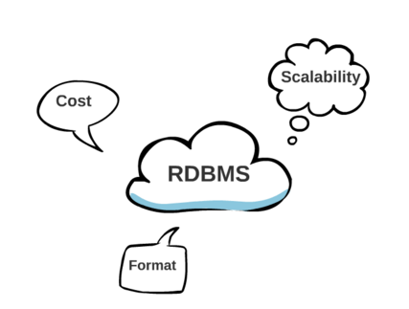
RDBMS – Not the right choice for Big Data
Considering the type and volume of data RDBMS is not the right choice for storing Big Data

Slide 7


Hadoop : The Savior
Hadoop

Slide 8

What is Hadoop ?
Apache Hadoop is an open source, scalable and reliable solution that stores and allows distributed processing of large data sets across clusters of computers using simple programming model

Slide 9
A closer look at Apache Hadoop
Apache Hadoop includes following modules :
Hadoop Distributed File System (HDFS): A distributed file system
Hadoop Common: The common utilities that support the other Hadoop modules
Hadoop YARN: A framework for job scheduling and cluster resource management
Hadoop MapReduce: A YARN-based system for parallel processing of large data sets

Slide 10
High Availability

Slide 11
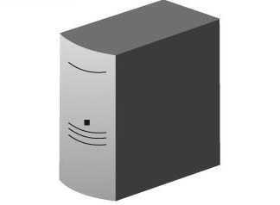
Maintaining High Availability
In Distributed Computing, failure is a norm, which means YARN should have acceptable amount of availability
Client
get Block Locations
NS
NameNode
Block Management
Read Data
Data
Node
Data
Node
Data
Node
….
NameNode - No Horizontal Scale
NameNode - No High Availability

Slide 12













NameNode: Single Point of Failure
metadata
Single Point
Failure
NameNode
Secondary NameNode:
"Not a hot standby" for the NameNode
Connects to NameNode every hour*
Housekeeping, backup of NemeNode metadata
Saved metadata can build a failed NameNode
You give me metadata every hour, I will make it secure
Secondary
NameNode
metadata

Slide 13
Hadoop 2.0 Cluster Architecture: High Availability
HDFS HIGH AVAILABILITY
HDFS
Client
All name space edits logged to shared NFS storage; single writer (fencing)
Shared edit logs
YARN
Read edit logs and applies to its own namespace
NameNode High Availability
Next Generation MapReduce
Secondary Name Node
Active NameNode
Standby NameNode
Resource Manager
DataNode
DataNode
Data Node
Node Manager
Node Manager
Container
App
Master
Container
App
Master
Node Manager
Node Manager
DataNode
DataNode
Container
App
Master
Container
App
Master
http://hadoop.apache.org/docs/stable2/hadoop-yarn/hadoop-yarn-site/HDFSHighAvailabilityWithNFS.html

Slide 14
Hands-On
Achieving HDFS and YARN High Availability

Slide 15
Hands-On
Securing through ACL

Slide 16

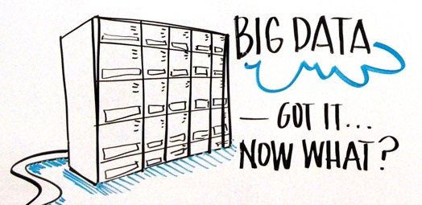
What to do with Big Data ?

Slide 17
Hadoop: The Perfect Data Warehouse
Free Text
Images/
Videos
Transaction
Logs
Sensors
HDFS Files
Metadata
HCatalog
HiveSQL
ImpalaSQL
Others …
Query Engines
Tableau
QlikView
Cognos
Pentaho
BI Tools

Slide 18
What is a Data Warehouse is good at ?
Among others, a data warehouse is the foundation for a successful business intelligence program
The Data Warehouse Institute
www.tdwi.org

Slide 19

Survey
Your feedback is vital for us, be it a compliment, a suggestion or a complaint. It helps us to make your experience better! Please spare few minutes to take the survey after the webinar.

Slide 20
Thank You …
Questions/Queries/Feedback
Recording and presentation will be made available to you within 24 hours

Slide 21
ZK
ZK
ZK
Heartbeat
Heartbeat
Failover Controller
Active
Failover Controller Standby
Shared storage
Monitors NN’s Health
Cmds
Monitors NN’s Health
NN Active
Sharead NN state with single writer
(fencing)
NN Standby
Block Reports to Active and standby NN: Update cmds from one
DN 1
DN 2
DN n
HDFS

Slide 22
2. Failure
4. Failover
Resource
Manager
Passive
Resource Manager
Active
3. ZKFC Detects
failure
ZKFC
ZKFC
3. Standby Node
become active
1. Active Node stores all state in ZKStore
ZooKeeper
ZooKeeper
RMState
RMState

Slide 23


Monitor and maintain active lock
Zookeeper Service
zookeeper
zookeeper
Monitor and try to take active lock
zookeeper
ZookeeperFC
ZookeeperFC
Monitor liveness & heath
Shared Edits
Monitor liveness & heath
Journal Node
Journal Node
Journal Node
Active
Read
Standby
NameNode
Write
NameNode
DataNode
DataNode
DataNode

